Slide 1
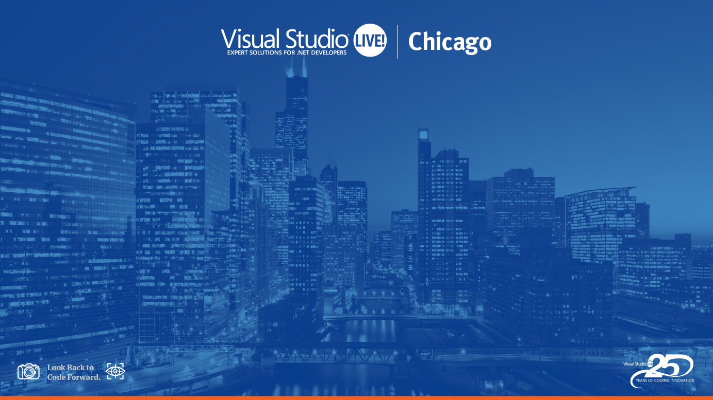
Core Azure Solutions:
Automation (Dev)
Josh Garverick
Application Architect
10th Magnitude
Level: Intermediate

Slide 2
Agenda
What’s the Big Idea?
What’s In It For Me?
Sharing is Caring
Local Environments
Cloud Environments

Slide 3
What’s the Big Idea?
Team Commitment
Consistent Experience (R&R)
Remove Friction and Roadblocks
Shift Left
Early Feedback
Catch Issues Before Committing
Notes:
Do we know why we want to shift left?

Slide 4
What’s In It For Me?
Learn how to:
Script out dev environments
Work with a team to streamline development
Use common tools
Promote reuse
Notes:
You will learn this stuff, so help me God

Slide 5
The Scenario
You work for a company that has six teams of engineers.
Each team works on a separate component of a larger platform.
Each team consists of 3-4 software engineers, 1 quality engineer, and 1 product manager.
Management does not want to keep or enforce standards. On anything.

Slide 6
Team Commitment
Empower teams to own CI/CD Definitions
Empower everyone to communicate changes
Provide repeatable building blocks to promote consistency
Agree on the process and a set of tools
Allow for flexibility
Notes:
Flexibility – allow for personalization without damaging the core functionality the team needs to share. Remember that greater flexibility can lead to more variance, which can lead to less consistent experiences.

Slide 7
Sharing is caring

Slide 8
What Should Be Shared?
Common Utilities
In-House Scripts / Apps
Build scripts
Generators
Templates
Frameworks and Libraries
Notes:
What about 3rd party apps? Discuss.

Slide 9
What Should Be Shared?
IDEs (maybe)
Extensions
Templates
Environmental Settings
Command Aliases
Common Locations (Source, Frameworks, etc.)
Environment Variables
Notes:
What do I mean by 3rd party apps? Things that all devs will want to use to make their experience smoother. For example, pipeline tools would fall into this. If developing databases, some tools like those offered by RedGate would fall into this as well.

Slide 10
What Should Be Shared?
Application Bootstrapping
Platform
Component
Quality Assurance
Static Analysis
Vulnerability Analysis
Automated Testing
Notes:
Bootstrap everything you can. The more you have automated, the less risk you have of differences between local dev and other environments in your pipeline.
Things such as docker compose, kubernetes will make this easier but will also introduce complexity in different areas.
After this slide, swap to demo 1

Slide 11
Local Environments

Slide 12
Local Environments
Incorporate Shared Components
Personal Preferences
IDE extensions
Keymapping
Command Aliases
Environment Variables
Notes:
After this slide, bounce to demo 2 (loading personal scripts during primary bootstrap)

Slide 13
Cloud Environments

Slide 14
Cloud Environments
Sandbox Resource Groups
DevTest Labs
Virtual Desktop Interface (VDI)
Azure Dev Spaces*
* Kubernetes only
Notes:
Sandboxes are good for non-iaas setups
DTL is really only suited for IaaS
VDI can extend repeatable setup to workstations
Dev Spaces is essentially namespace separation in a k8s cluster
Break for the last demo

Slide 15

Thank you!
@jgarverick
Joshgarverick.blogspot.com
github.com/jgarverick

